Slide 1
Build your own web search agents using local LLMs
ATxSG AI Summit
27-29 May, 2025
Notes:
All LLM calls will be from a LLM hosted on your laptop and free to use.
I will show it works first and then do a code walkthrough
Parameters: enter model, research iterations and research topic
Local LLM leadership board: https://huggingface.co/spaces/open-llm-leaderboard/open_llm_leaderboard

Slide 2

About Me
Current role: Senior Data Scientist
Previously: Consulting and Software Engineering
Alma matter: NUS, Singapore and PEC, India
Hobbies: Cricket, and non-fiction reading (mostly Newsletters :P)
Linkedin: Sahil Sharma

Slide 3
“
One of our big goals in search is to make search that really understands exactly what you want, understands everything in the world.
- Larry Page, Cofounder, Google
“
Notes:
The pre ChatGPT era can be considered as the stone age for Search and with the introduction of LLMs, Search has found it machines in AI that would make humans job little easier.

Slide 4
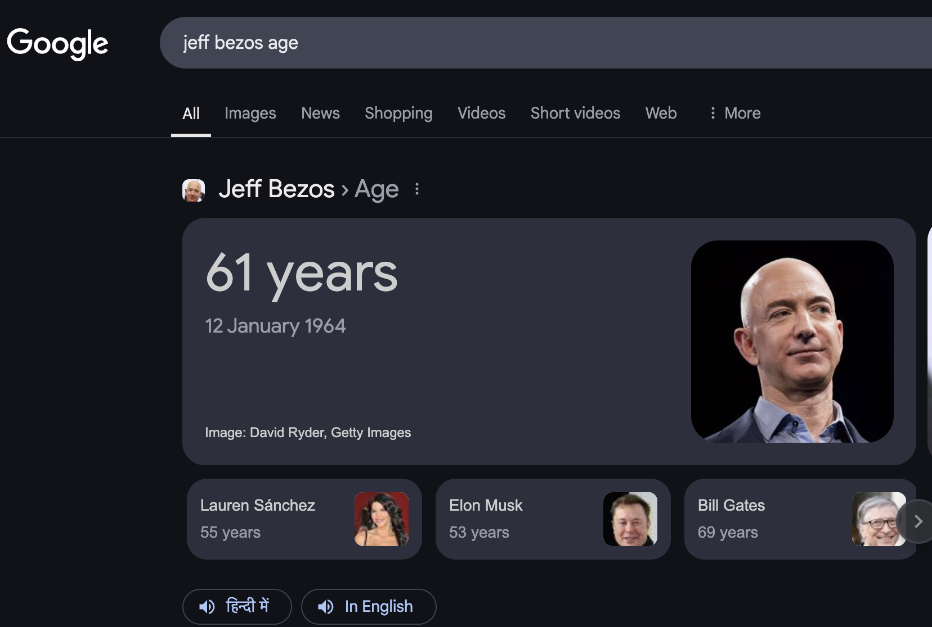
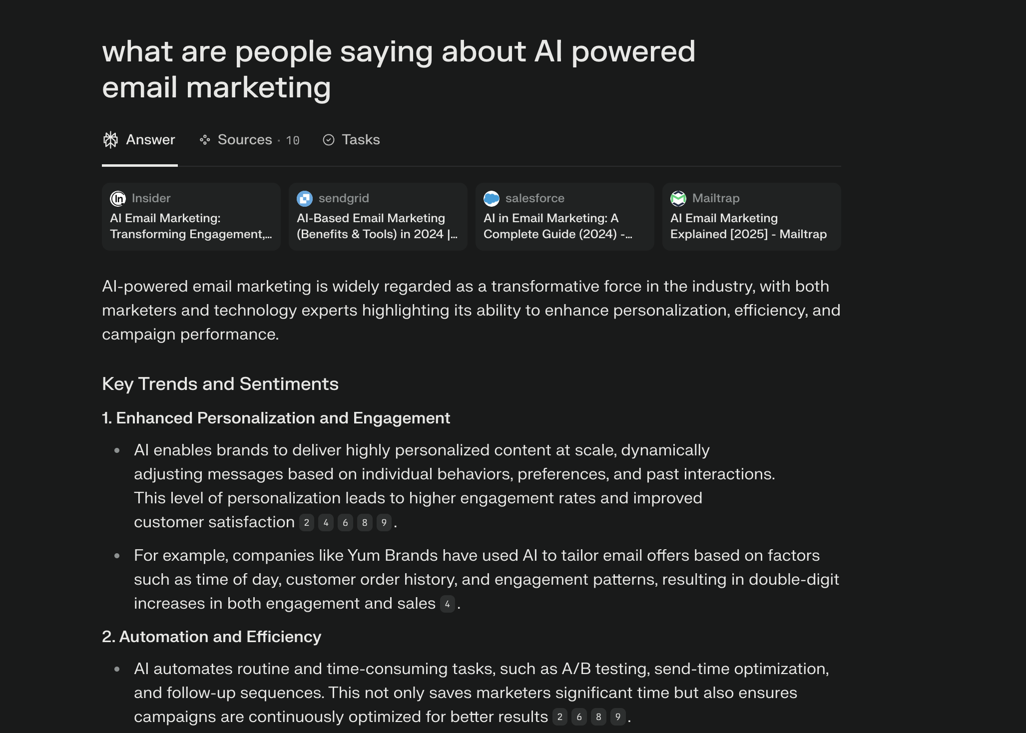
Traditional Search vs AI assisted search
Notes:
Its important to internalize how search has been transformed with AI.
An average google search has traditionally been 2-3 words however, an average AI search on tools like perplexity is 10-11 words. AI searches can be more analytical.
Google search eg: Elon musk age
Perplexity search example: since 2014 how many centuries has Virat Kohli scored in a chase?
Stats:
Today around 1 billion searches per day on google are just key words.
Perplexity has 20 million searches per day. Both platforms as of today have same number of words (same ballpark) and that’s very surprising.

Slide 5


Credits to this guy
Who built this
Aravind Srinivasan
Notes:
Who truly internalized Larrys goal? An former intern at his company- Aravind Srinivas, who later on built perplexity.ai.
Perplexity at one point in 2024 was 1/15th the evaluation of OpenAI (which is massive). So they clearly were doing something more than being just a LLM wrapper.
Although, despite having first movers advantage, it’ll be interesting to see how long can perplexity survive given all mainstream LLM organisations have strated to include live web search in LLMs.
Knowledge is everything. Period.

Slide 6
Core components of a web search agent
Large Language Model (LLM, e.g., Llama 3.3): Serves as the agent’s central intelligence, interpreting user inputs, forming search queries, and analyzing the information gathered.
Search Tool: Enables the agent to access and retrieve information from the web, typically through a search engine API.
Prompt Template: Provides a structured format for delivering information to the LLM, ensuring that inputs are clear and comprehensive.
Agent Executor: Coordinates the workflow, managing the interaction between the LLM and external tools to carry out the agent’s tasks efficiently.
Notes:
why langchain is really good? chainable omponents, tool integration, memory management, extensibility

Slide 7
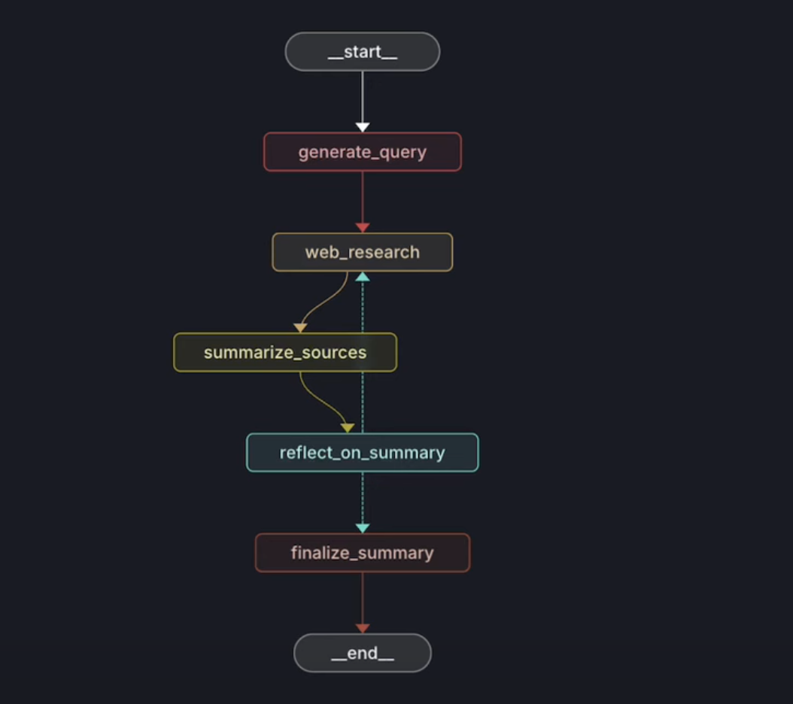
Workflow of a web search agent
Notes:
User query= check
Generate more context around the query (or generate similar queries) with query enhancer
Use web search api to get search results for each query: : does web search multiple times on enhanced context before sending it to next page
Send response to summarizer LLM
Reflect on Summary generated, evalute whether this fully covers parts of original query. If not, repeat from step 2 (query enhancer) untill n number of times (n= upper limit defined by user)
Send final collated response to another summarizer LLM to present search report.
The above is a simple workflow. What we can do is first have a research planner agent who plans section flow then multiple research writer agents who fill in details for each section

Slide 8
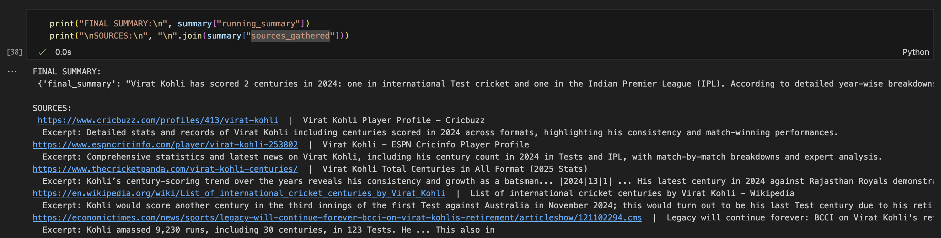
App Response
Notes:
User query= how many centuries has Virat Kohli scored in 2024?
Generate more context around the query (or generate similar queries) with query enhancer
Use web search api to get search results for each query: : does web search multiple times on enhanced context before sending it to next page
Send response to summarizer LLM
Reflect on Summary generated, evalute whether this fully covers parts of original query. If not, repeat from step 2 (query enhancer) untill n number of times (n= upper limit defined by user)
Send final collated response to another summarizer LLM to present search report.
The above is a simple workflow. What we can do is first have a research planner agent who plans section flow then multiple research writer agents who fill in details for each section
Going into the detail of app response:
Honestly, I’m more instead in the quality of web sources

Slide 9
Code Walkthrough
Notes:
Add screen record
Credits to langchain: https://github.com/langchain-ai/local-deep-researcher

Slide 10
Tech Stack
Ollama/Groq (LLM Platform/AI inference)
Tavily/Duck Duck Go (Search Engine API)
Langchain/llamaindex/Crew AI (LLM Agent Orchestrator)

Slide 11
Secret Sauce for a great web research agent
Response and prompt caching
Latency (Fast/slow path optimization)
Difficulty-aware routing
(optimize effort per query)
Dynamic LLM routing, multi LLM
Source ranking + citation
Location/ Demography-awareness
Notes:
- Write more

Slide 12
Thank you!

Slide 13
SECTION NAME
A surface is that which has length and breadth only.
Longer description of slide content. Typically used to provide extra context or nuance to slides. A good description ensures slides can be consumed async without a live presentation.

Slide 14
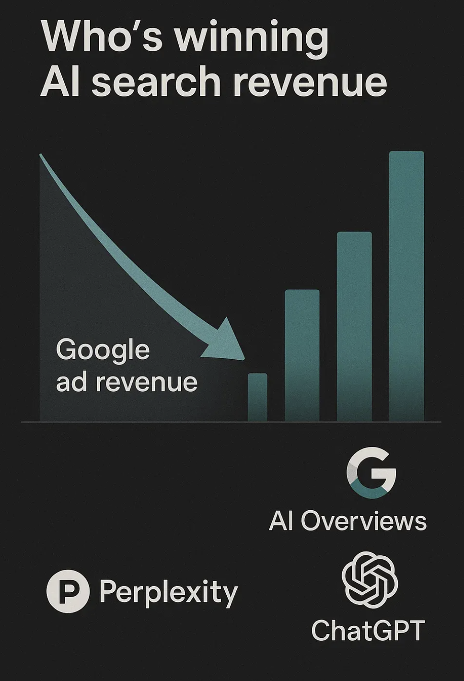
Who’s winning AI search revenue
Google ads revenue
(transition) Who’s taking Google ads revenue
Notes:
As AI search is advancing the google ads revenue is tumbling and the big debate is who is clinging to googles loses in search space. Major players: chatgpt, perplexity, etc
Perplexity, though often criticized as LLM wrapper, has first movers advantage because they dived into the space much much earlier than other companies.

Slide 15
BEFORE
AFTER

Slide 16
SECTION NAME
An obtuse angle is an angle greater than a right angle.
“
A quote from a customer, user, or other stakeholder that helps back up the point you’re trying to make on this slide.
Longer description of slide content. Typically used to provide extra context or nuance to slides. A good description ensures slides can be consumed async without a live presentation.
— JANE DOE

Slide 17
TIMELINE
Longer description of slide content. Typically used to provide extra context or nuance to slides. A good description ensures slides can be consumed async without a live presentation.
JANUARY
AUGUST
v1 design
v2 design
Brand asset design
Engineering exploration
Web implementation
Android implementation
iOS implementation
User testing & research

